Slide 1
Capstone Pneumonia Detection
Computer Vision
Object Detection Model Solutions

Slide 2
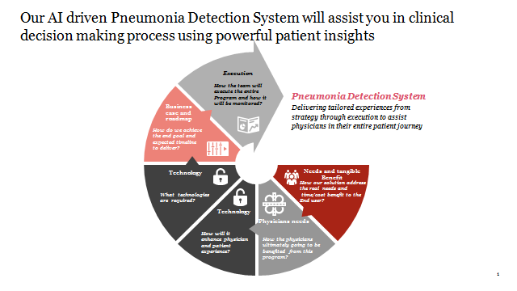
Project

Slide 3
Data Visualization
1. General Visualization

Slide 4
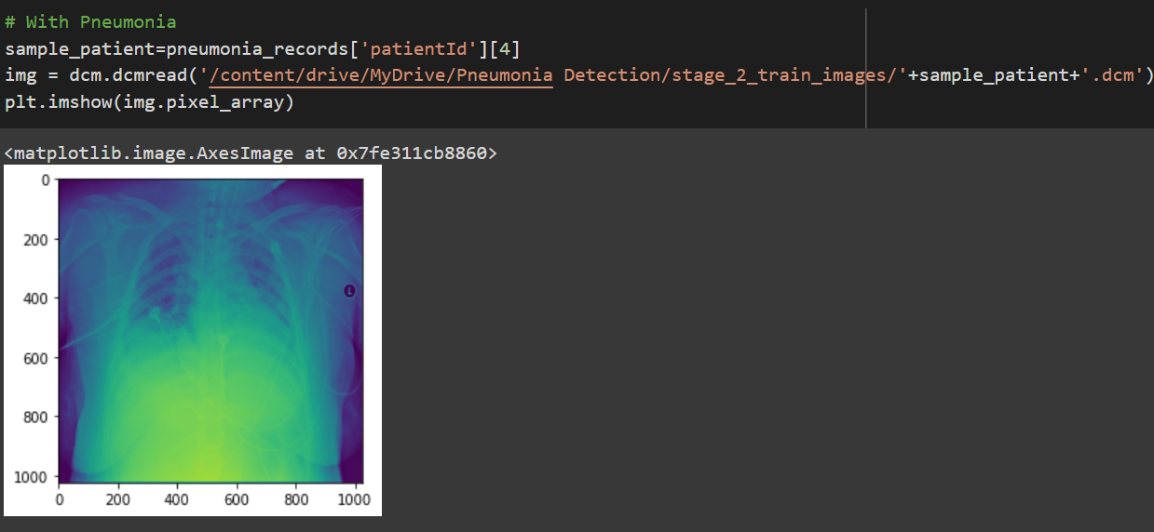
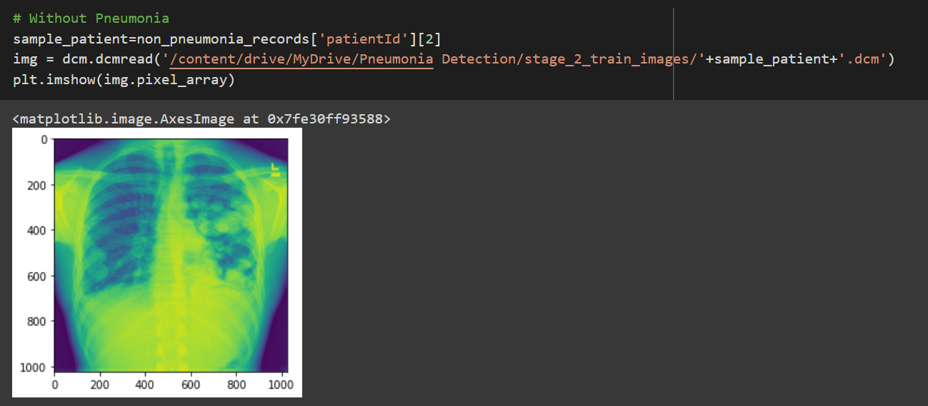
Dicom Image Visualization
NB: Converted and resized these images after getting metadata from Dicom files for better data processing

Slide 5
Data Visualization
2. Visualization Based On Train Set (CSV Files)

Slide 6
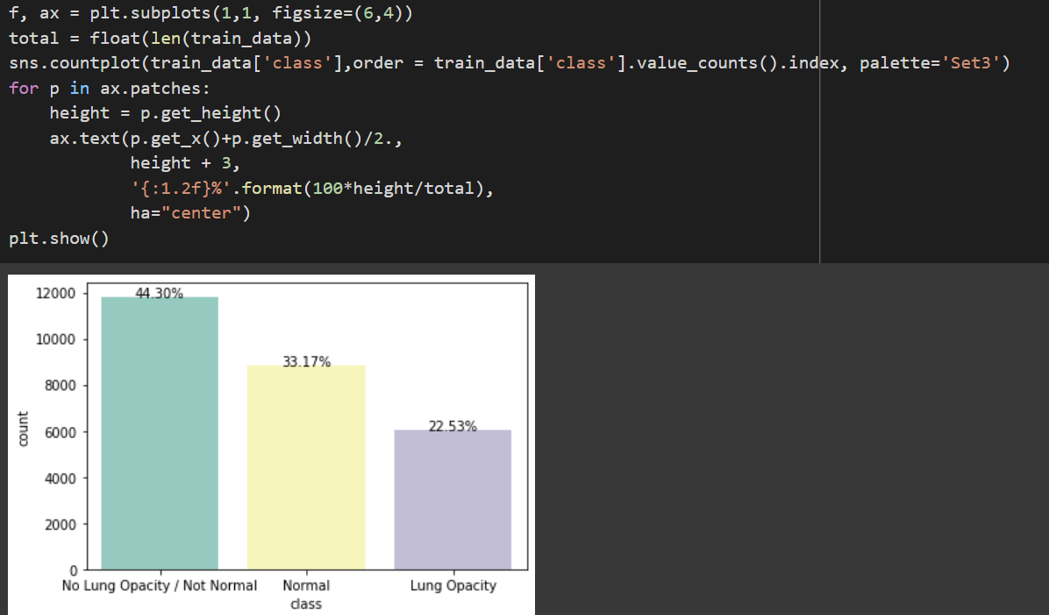
1. Class Distribution (Percentage Count)

Slide 7
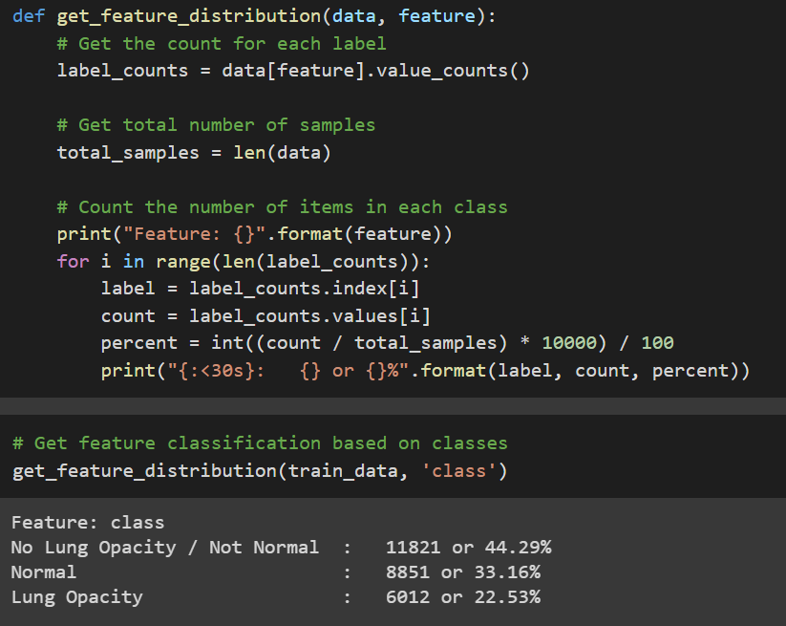
2. Feature-wise Classification Function And Its Usage For Class Based Classification Of Data

Slide 8
Data Visualization
3. Other Visualizations

Slide 9
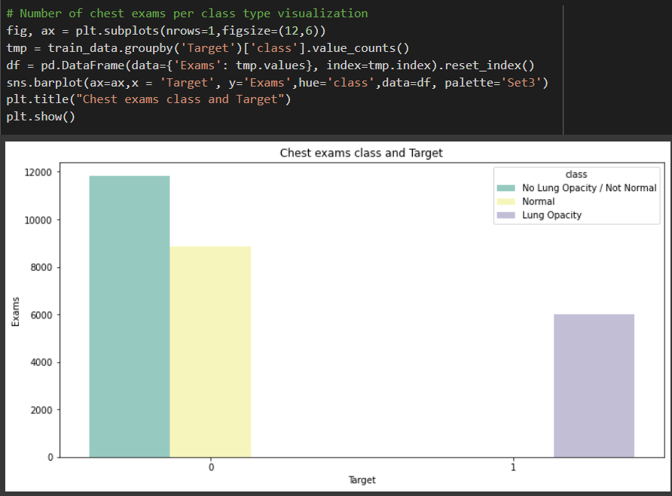
1. Number Of Chest Exams Based On Class

Slide 10
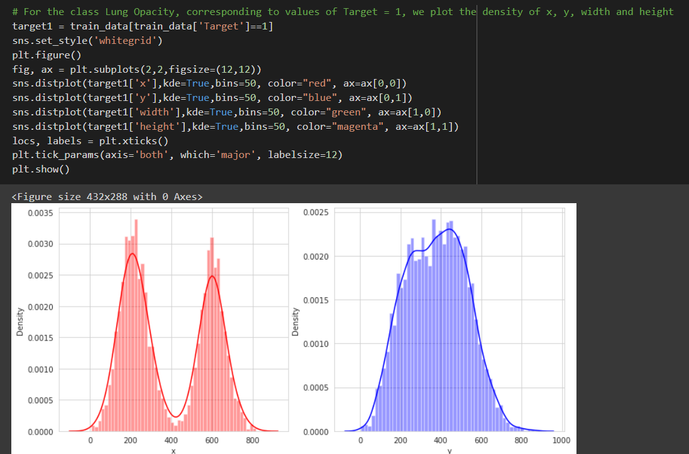
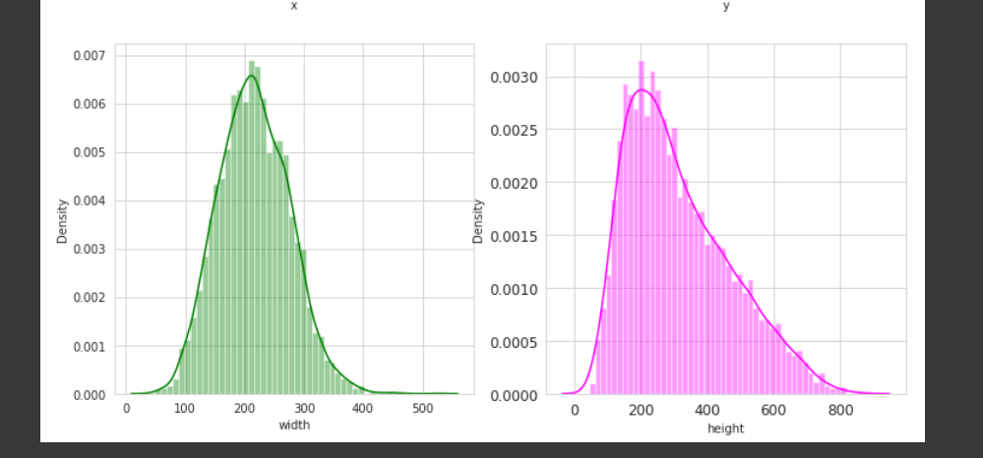
2. Lung Opacity And Coordinates

Slide 11
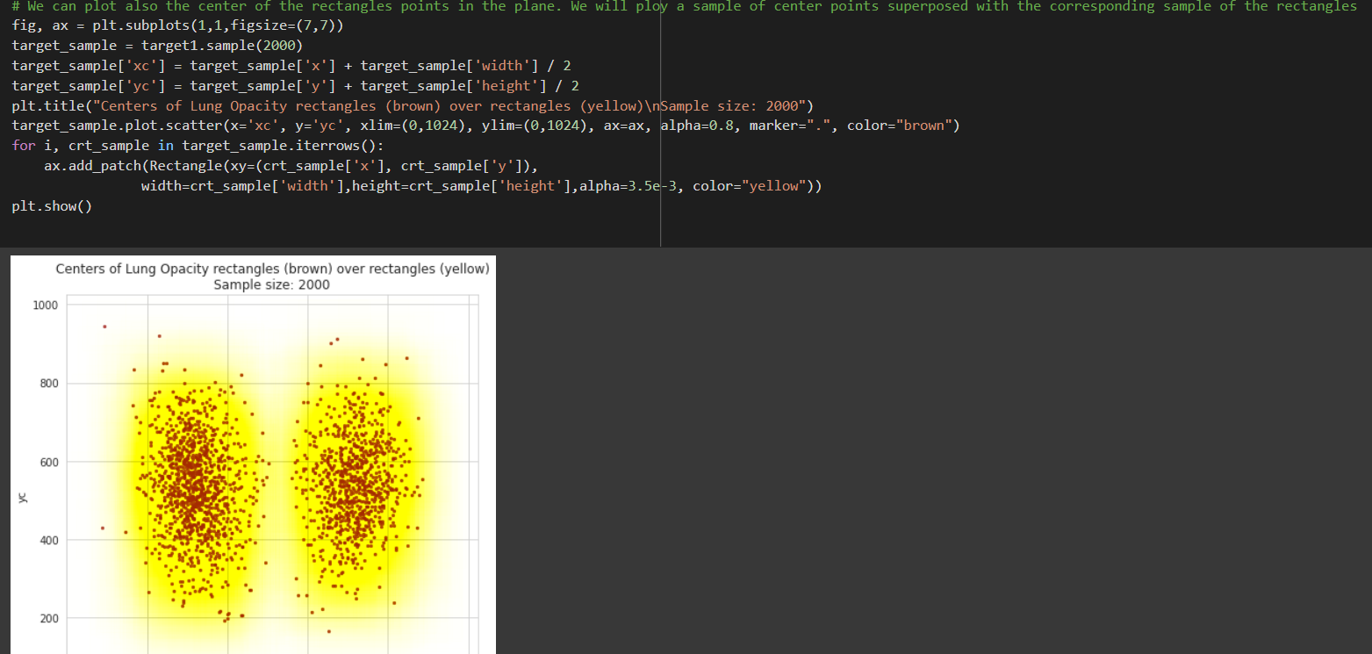
3. Centre Of Lung Opacity

Slide 12
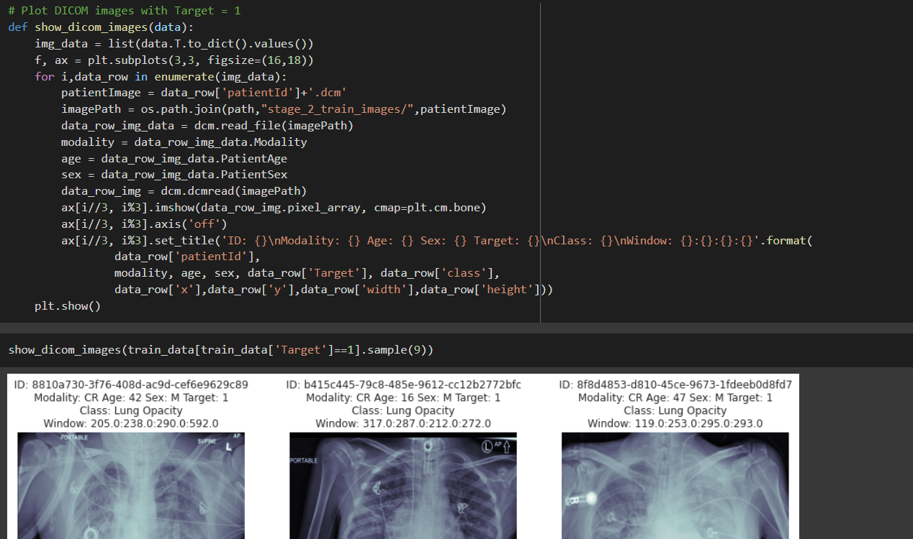
4. Dicom Image Plotting For Pneumonia

Slide 13
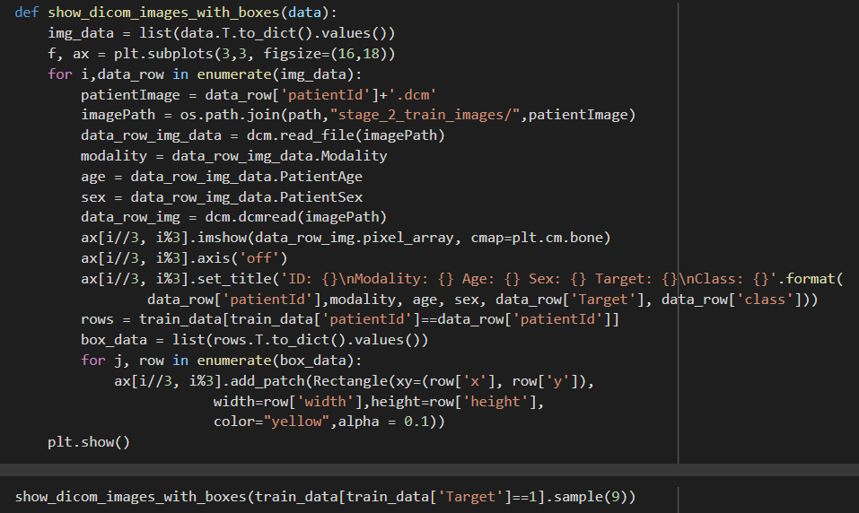
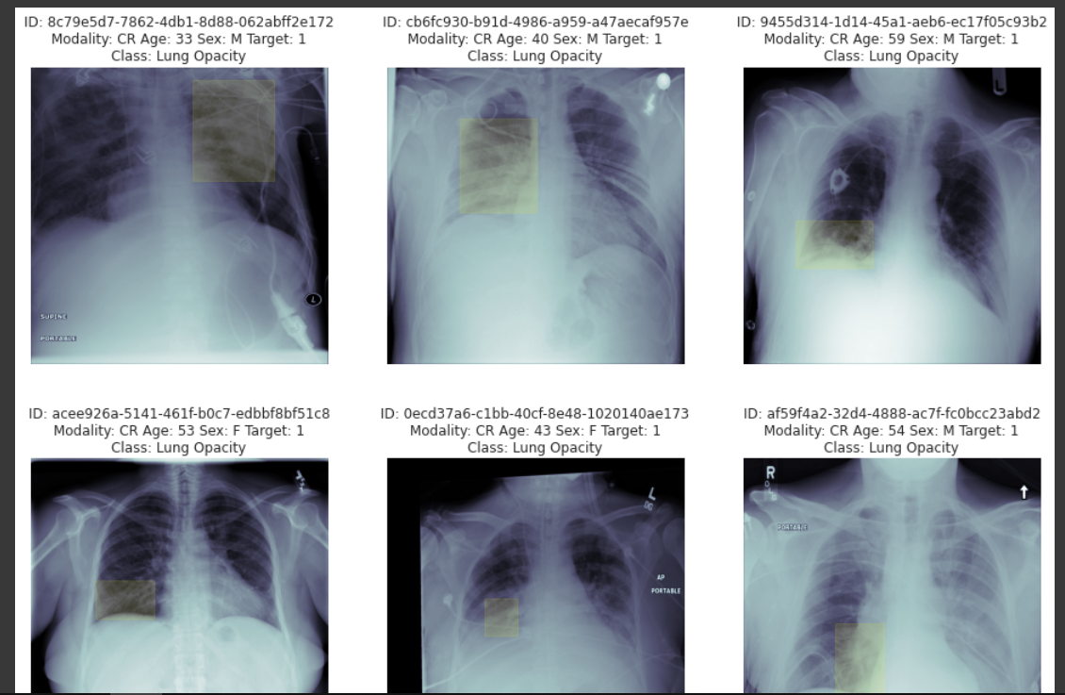
5. Box Plotting For Pneumonia Cases
Now represent the images with the overlay boxes superposed. For this, we will need first to parse the whole dataset with Target = 1 and gather all coordinates of the windows showing a Lung Opacity on the same image

Slide 14
Data Visualization
4. Meta Data Information And Visualization

Slide 15
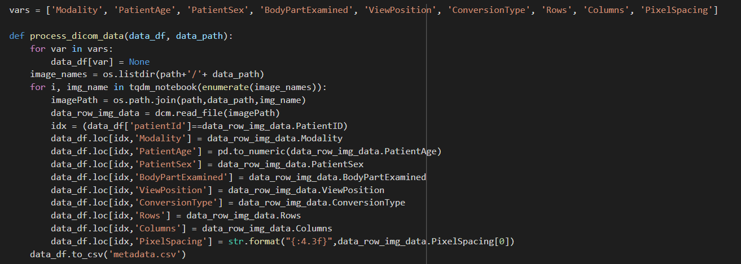
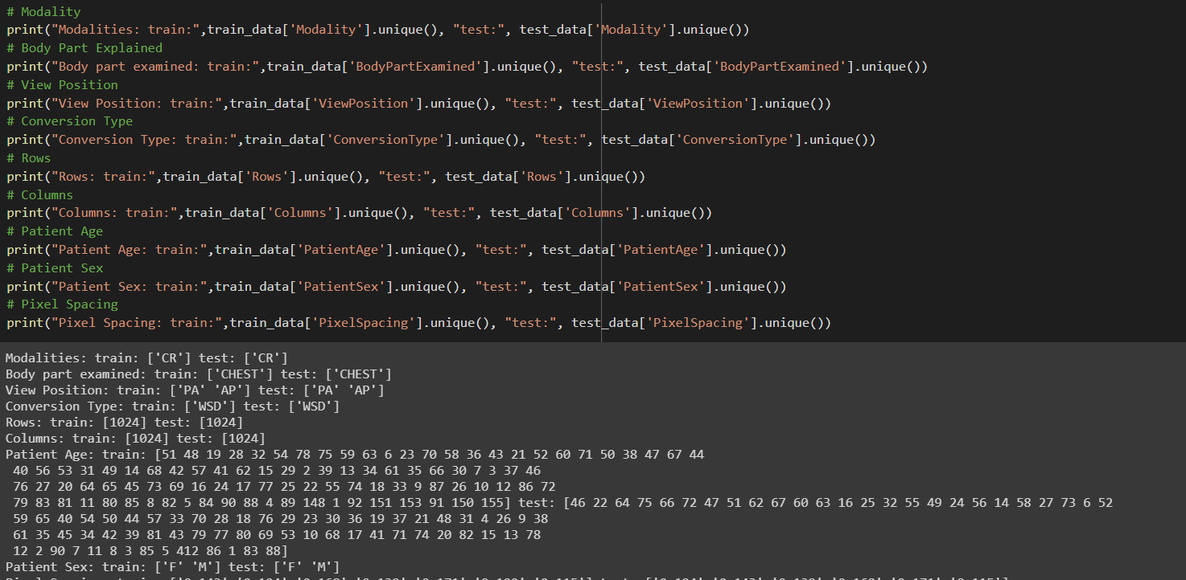
Dicom Meta Data Used

Slide 16
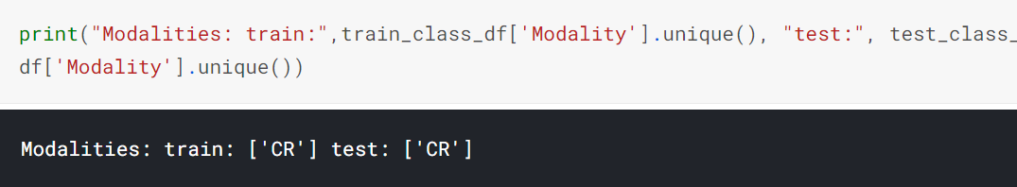
1. Modality

Slide 17
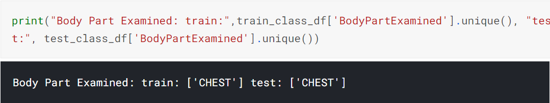
2. Body Part Examined

Slide 18
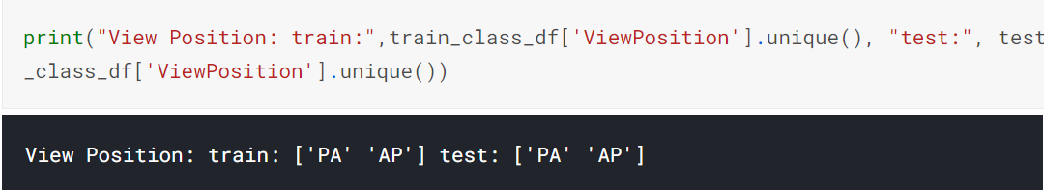
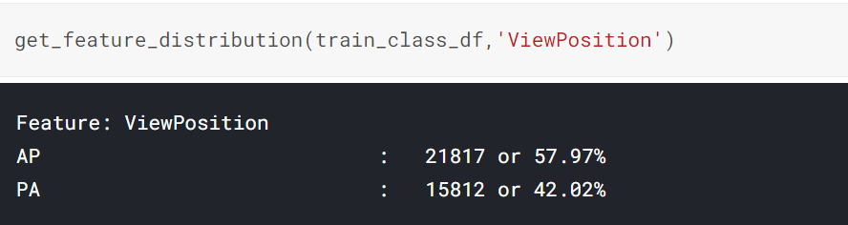
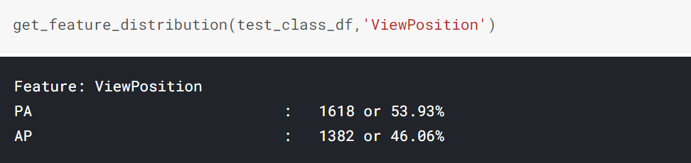
3. View Position

Slide 19
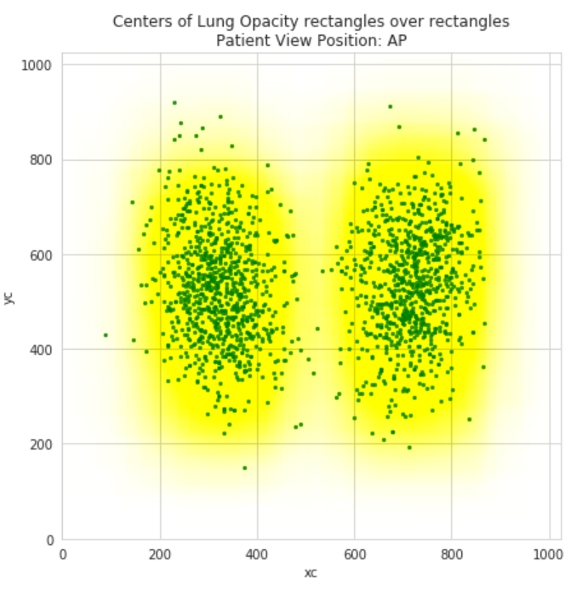
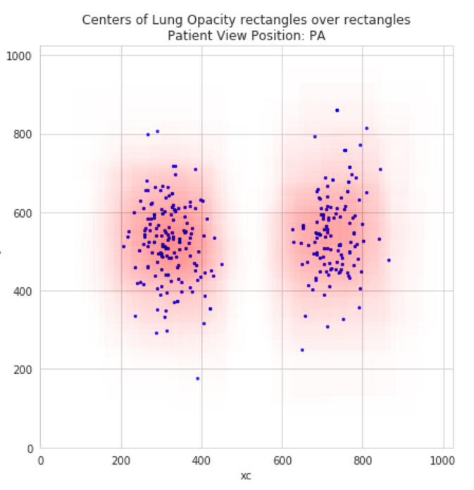

Slide 20
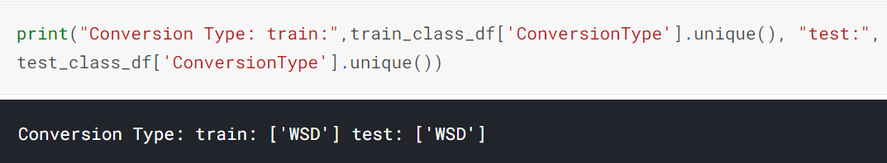
4. Conversion Type

Slide 21
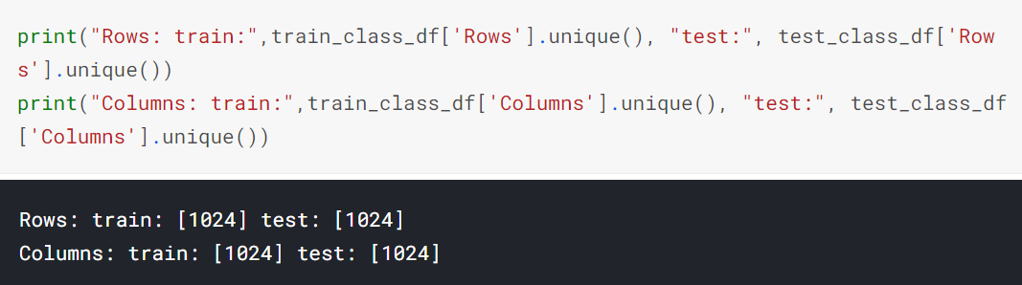
5. Rows And Columns

Slide 22
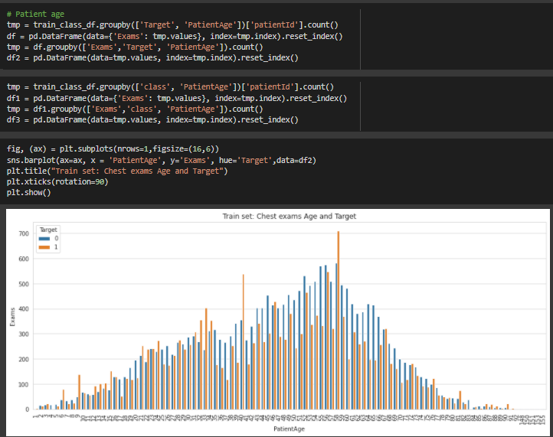
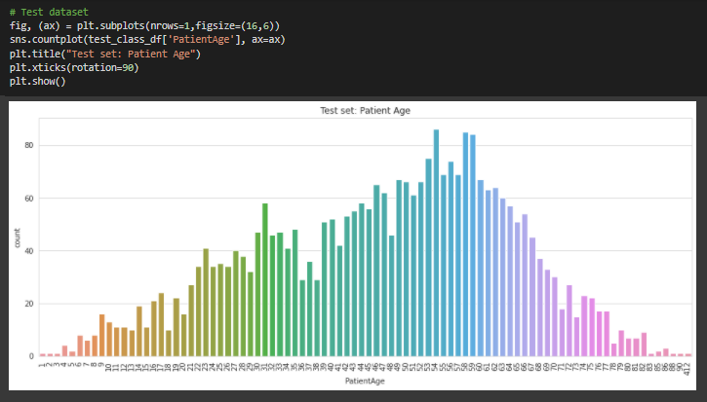
6. Patient Age

Slide 23
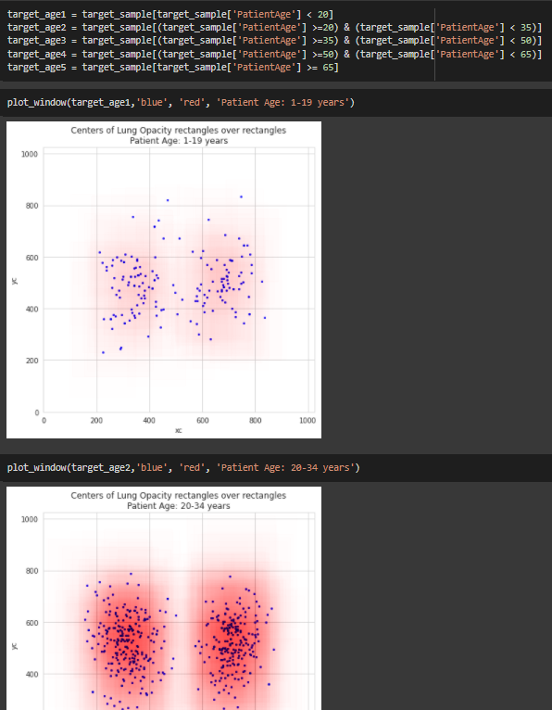
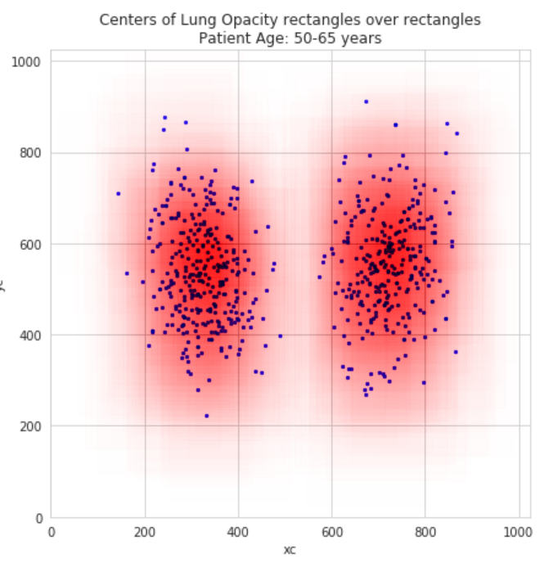
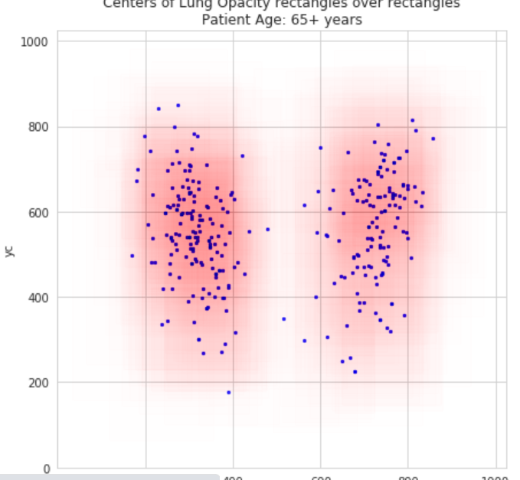
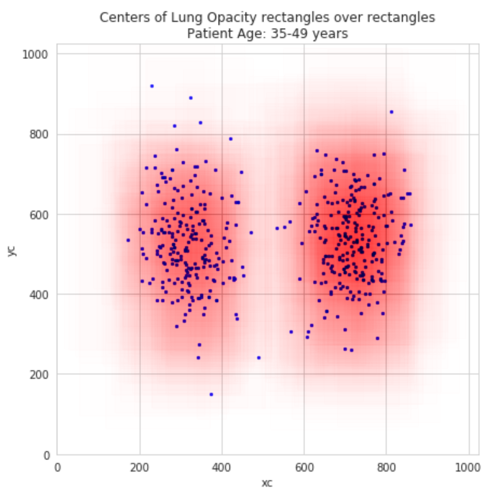

Slide 24
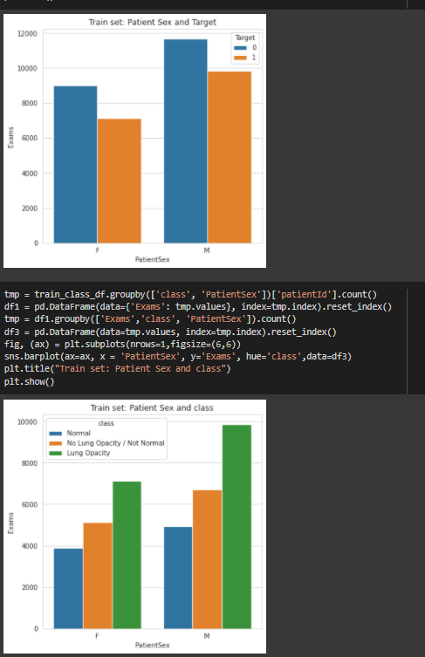
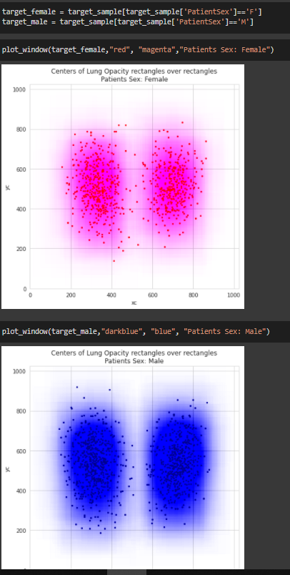
7. Patient Sex

Slide 25
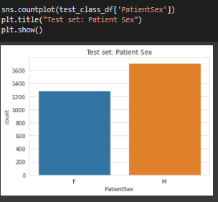

Slide 26
Models Implemented

Slide 27
Basic Model - CNN
Mask RCNN
EfficientDET
SSD
Final Model - Yolo v5

Slide 28
Basic Model - CNN

Slide 29
CNN - Model
CNN model is tried for this problem statement to get insights into challenges and compare results with using traditional CNN models for complex real world problems
CNN was applied on data using: (a) traditional pixel array approach (b) data generated using Image Generators (pre-processing required for converting DICOM to PNG files)
Experiment was done both on Grayscale and RGB data. Better results are observed with Grayscale data
Image generators speed up the data pre-processing and useful in augmentation. Freezing the layers is a good approach to reduce processing time
DenseNet (with RGB data only) gave good results

Slide 30
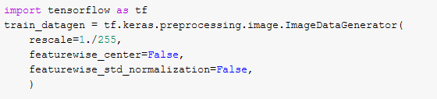
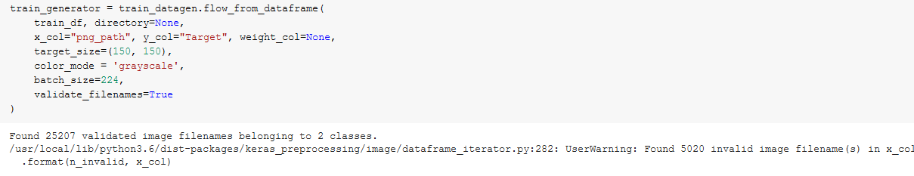
CNN - Model
Image generators

Slide 31
CNN - Results
CNN gave accuracy of 80 to 82% with 0.80 recall value
CNN Results when compared with Object Detection models, indicate object detection models are more apt for solving the problem at hand for more accurate and visible results
Object detection models provide more justification to the results by displaying bounding boxes. CNN results are more of a black box and hence less convincing (specifically in medical fields)

Slide 32
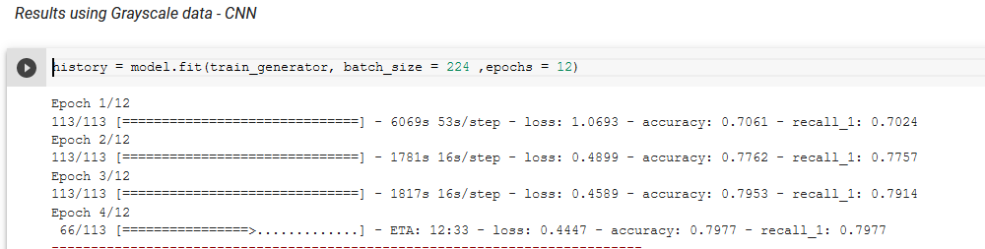
CNN - Results
Accuracy – 80%, Recall (class 1) – 0.8

Slide 33
Mask RCNN

Slide 34
Mask RCNN - Model
Github implementation - https://github.com/matterport/Mask_RCNN.git
In built class and methods for data generators
Predictions customized on basis of roi scores and confidence values
Hyper parameter tuning done on confidence score and achieved optimal value of 0.94

Slide 35
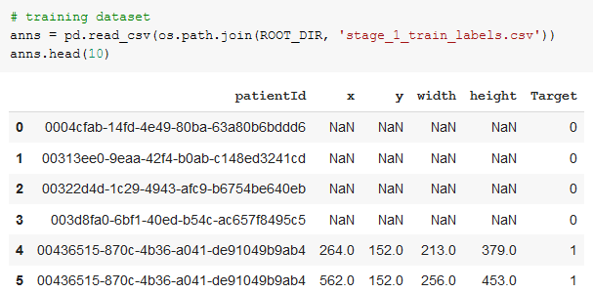
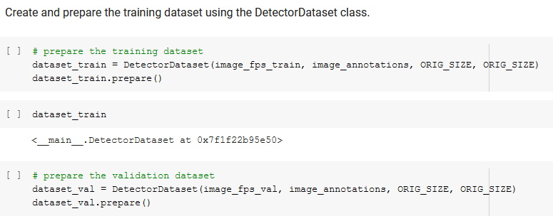
Mask RCNN - Model
Data Preparations – annotations file and inbuilt DataDetector class

Slide 36
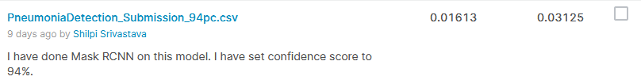
Mask RCNN - Results
Model validation Loss ~ 2.5
Score on Kaggle on test set of files: 0.03125

Slide 37
SSD

Slide 38
SSD - Model
Github implementation - https://github.com/pierluigiferrari/ssd_keras
Dataset prepared as required in the model – image files, directories, labels and annotations
Parse_csv used for reading annotations
Understanding SSD architecture was a major takeaway
Predictions done using decode_detections
Hyper parameter tuning was done on confidence and iou thresholds

Slide 39
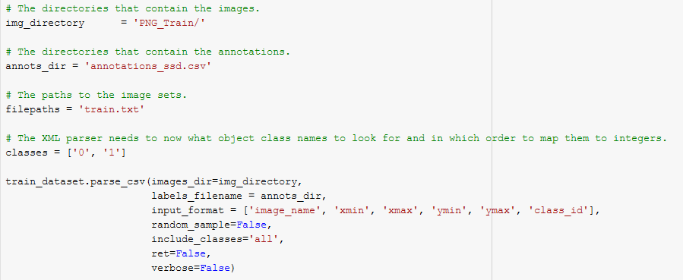
SSD - Model
Data preparations

Slide 40
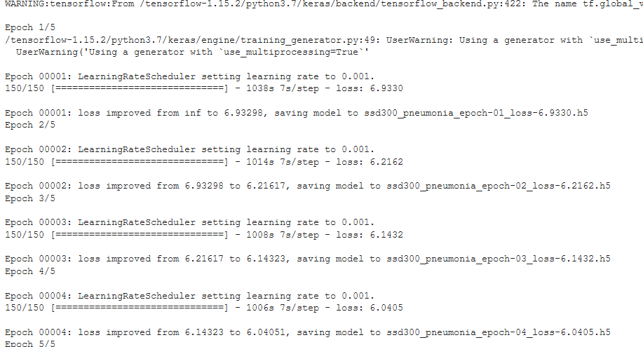
SSD - Results
Model validation Loss ~ 6.0
Score on Kaggle on test set of files: 0.000

Slide 41
Yolov5

Slide 42
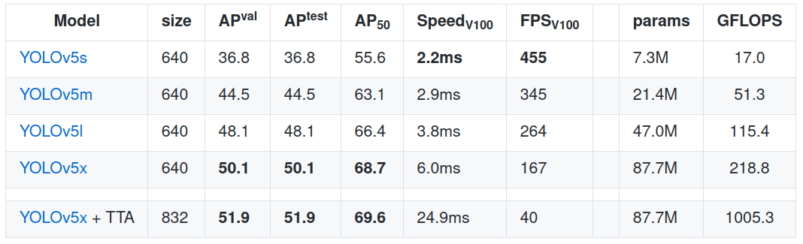
Yolov5 - Benchmark
Reference: https://github.com/ultralytics/yolov5c

Slide 43
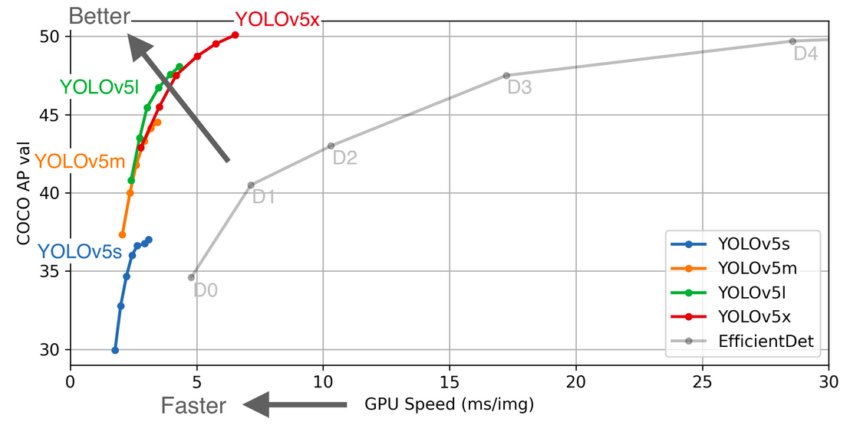
Yolov5 - Benchmark
Reference: https://github.com/ultralytics/yolov5c

Slide 44
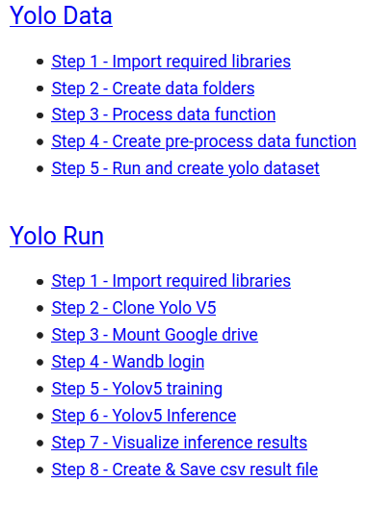
Yolov5 - Steps

Slide 45
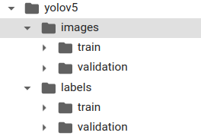
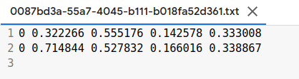
Yolov5 - Dataset

Slide 46
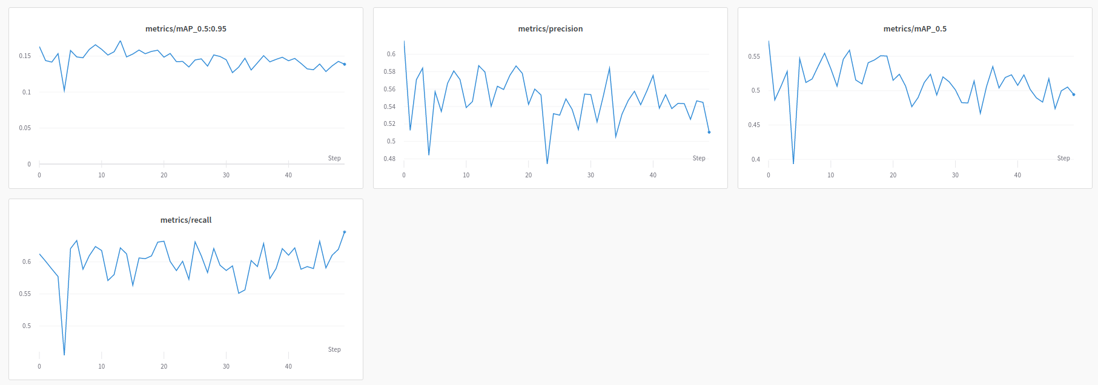
Yolov5 - Results

Slide 47
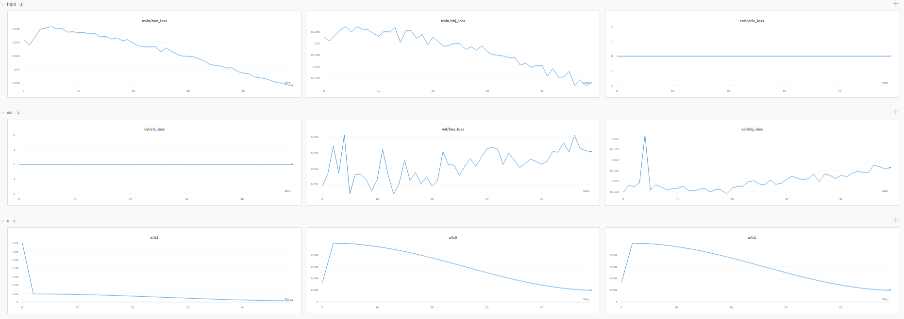
Yolov5 - Results

Slide 48
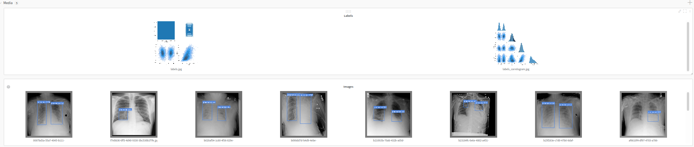
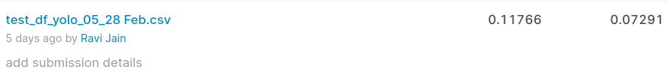
Yolov5 - Results

Slide 49
EfficientDet

Slide 50
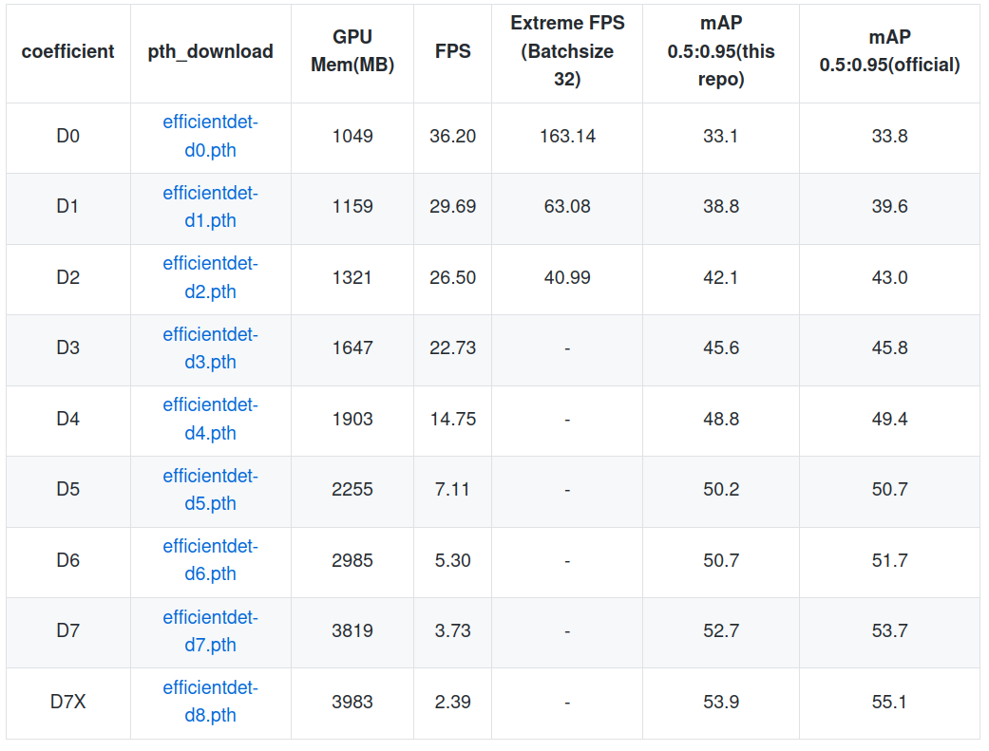
EfficientDet - Benchmark
Reference: https://github.com/zylo117/Yet-Another-EfficientDet-Pytorch

Slide 51

EfficientDet - Steps

Slide 52


EfficientDet - Dataset

Slide 53


EfficientDet - Results

Slide 54
Results Comparison

Slide 55
Model | Kaggle Score | Loss / Accuracy / Recall | Key Challenges
Yolo v5 | 0.12 |  | Using Github repo, Using wandb
Mask RCNN | 0.03 | Loss - 2.5 | Data preparations, hyper tuning
SSD | 0.000 | Loss - 6.0 | Model understanding, Data preparations, hyper parameter tuning
CNN |  | Accuracy – 80% Recall – 0.8 | Data preparations, hyper parameter tuning, results evaluation
EfficientDet | 0.003 |  | Creating coco datformat

Slide 56
Key Challenges & Learning

Slide 57
Data processing using pixel arrays was time consuming. Used Image Generators
Different Object detection models architecture understanding
Data preparations according to model implementation was a challenge
Hyper parameter tuning done on roi scores, confidence scores, learning rates etc in various models
Large size image and data constraint
Slow speed training with 1024 * 1024
Google Colab usage constraint

Slide 58
Learned wandb to track results
Importance of managing libraries version
Reviewing PaperswithCode.com to review various models
Using popular github repositories
Using right batch size based on resources availability
Callback usage to manage training time
Dual-Stage Detection and Single Stage Detection
Dual stage → The first stage generates the regions of interest (object proposals), while the second stage classifies these proposals and locates the objects using bounding box regression.

Slide 59
Single stage→ the detector skips the region proposal stage, and directly classifies and locates the bounding boxes.
Usage of GPU and TPU
Image resizing and conversion before processing
Data Augmentation, Val loss, Call backs, Submission file generation, etc.
Model and model weight saving to drives and analysis of various models and weights
Usage of CV scores
Kaggle submission

Slide 60
Research Papers & References

Slide 61
Object detection with efficientnet and efficientdet
https://www.cellstrat.com/2020/03/27/object-detection-with-efficientnet-and-efficientdet/
Multi-Objective Evolutionary Design of Deep Convolutional Neural Networks for Image Classification
https://paperswithcode.com/paper/multi-criterion-evolutionary-design-of-deep
Deep Learning for Automatic Pneumonia Detection
https://paperswithcode.com/paper/deep-learning-for-automatic-pneumonia
MUXConv: Information Multiplexing in Convolutional Neural Networks
https://paperswithcode.com/paper/muxconv-information-multiplexing-in
Pneumonia Detection in Chest Radiographs
https://paperswithcode.com/paper/pneumonia-detection-in-chest-radiographs/review/
COVID-CXNet: Detecting COVID-19 in Frontal Chest X-ray Images using Deep Learning
https://paperswithcode.com/paper/covid-cxnet-detecting-covid-19-in-frontal
OBJECT DETECTION AND IDENTIFICATION A Project Report
https://www.researchgate.net/publication/337464355_OBJECT_DETECTION_AND_IDENTIFICATION_A_Project_Report
Object Detection with Deep Learning: A Review
https://arxiv.org/pdf/1807.05511.pdf
Build your Own Object Detection Model using TensorFlow API
https://www.analyticsvidhya.com/blog/2020/04/build-your-own-object-detection-model-using-tensorflow-api/

